Slide 1
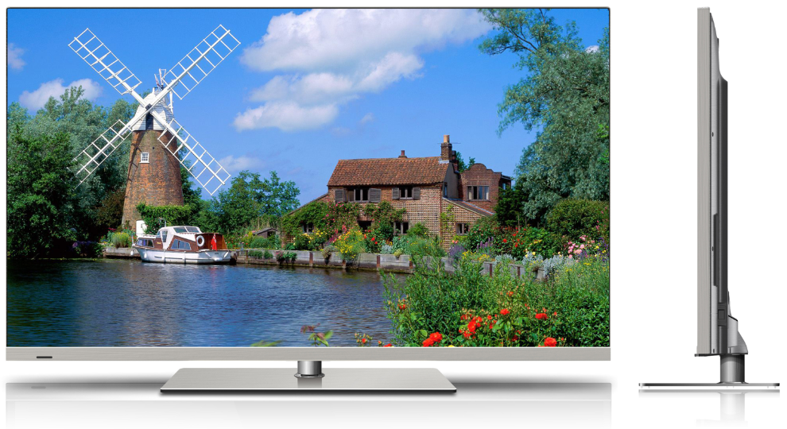
GD LED TV Proto Show

Slide 2
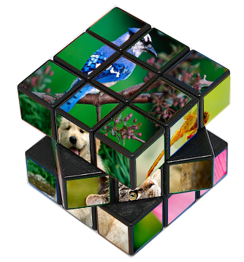
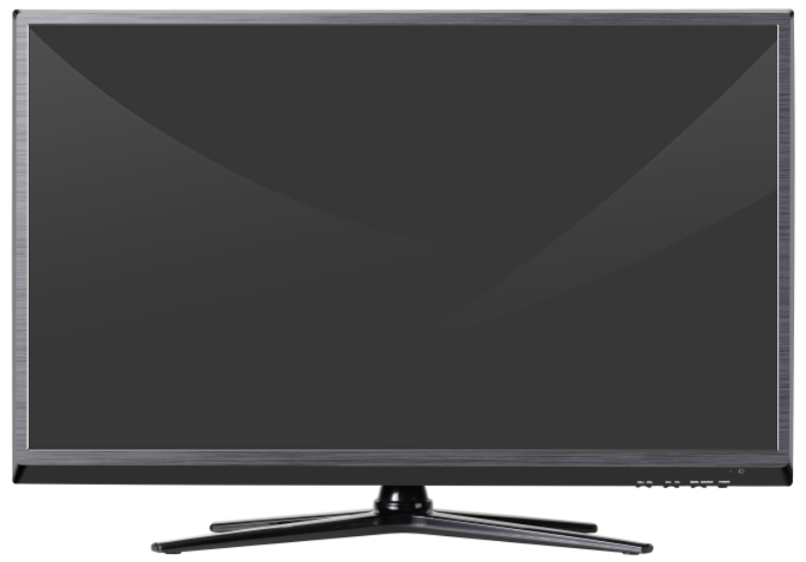
DLED Series
Direct Light-Emitting Didode Television
Size Variation : 15” / 35” / 45” / 52’’
Models : blah blah blah
Features : blah blah blah

Slide 3
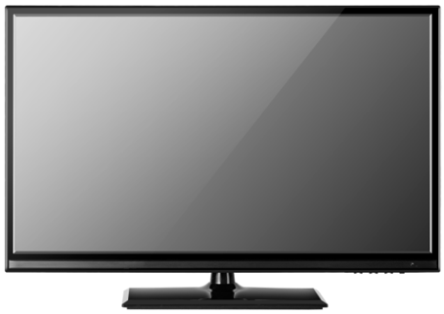
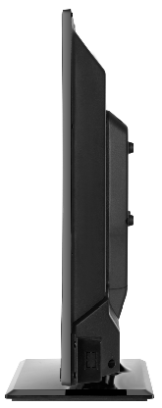
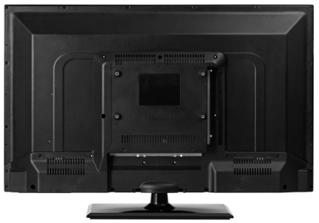
DLED Series
K3
Screen size : 31.5’’/39’’
Super slim frame, options with glossy and brush
DVD combo optional
Rotatable standee

Slide 4
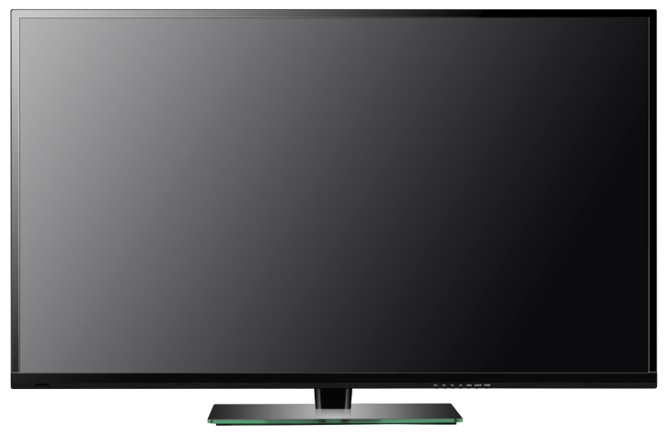
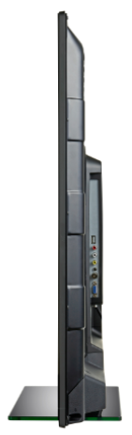
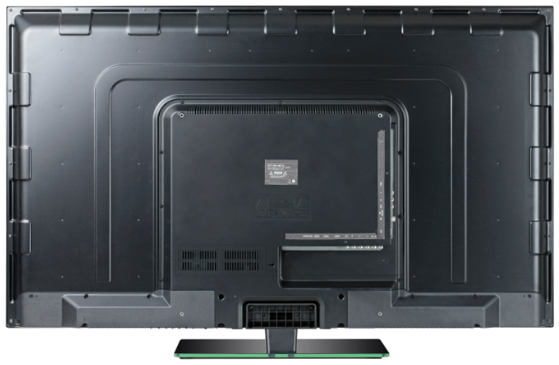
DLED Series
K8
Screen size : 32’’/39’’/40’’/42’’/46’’/50’’
Super slim frame, highly glossy only
DVD combo optional
Fixed standee

Slide 5
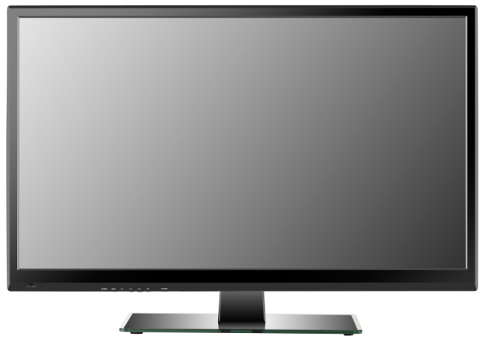
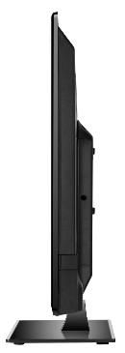
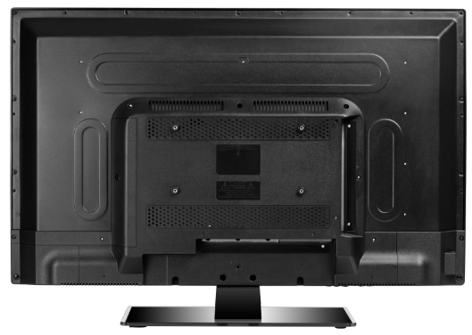
DLED Series
K6
Screen size : 27.5”/32’’/40’’/42’’
Super slim Frame
DVD combo optional
Glass standee

Slide 6


SSF Series
Super Slim Frame Television
Size Variation : 15” / 35” / 45” / 52’’
Models : blah blah blah
Features : blah blah blah

Slide 7
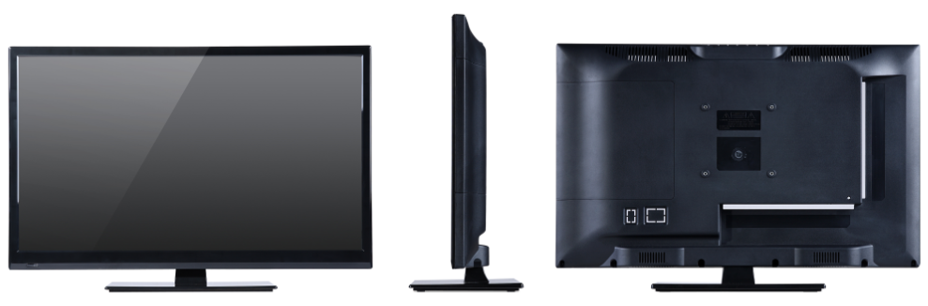
SSF Series
L1
Screen size : 15.6’’/18.5’’/19.5’’/21.5’’/23.6’’
Super slim frame of 14mm
Frame options with metal brush and high gloss
DVD combo optional

Slide 8
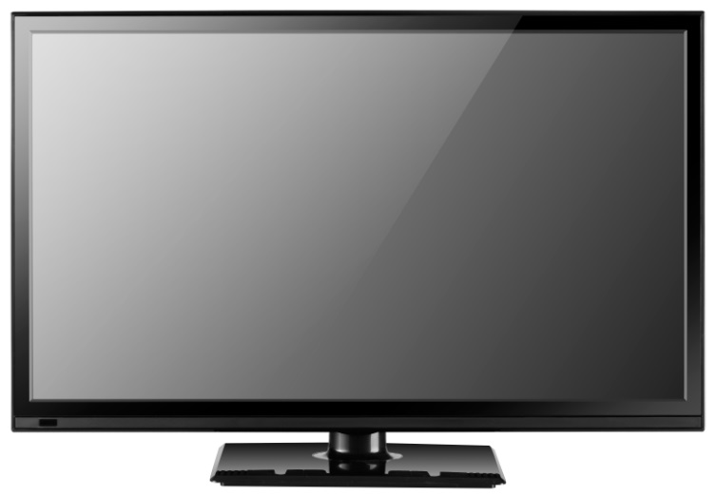
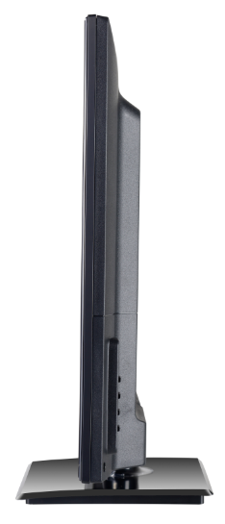
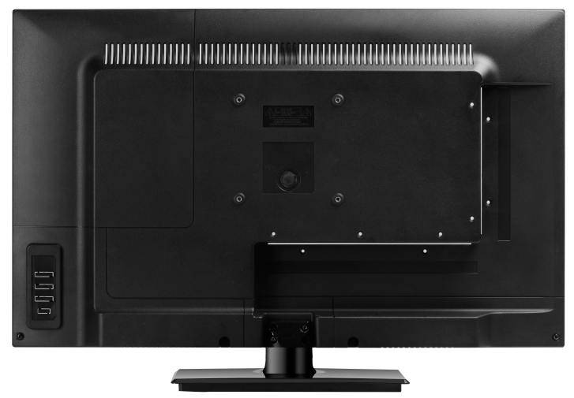
SSF Series
L9
Screen size : 15.6’’/18.5’’/21.5’’/23.6’’/24’’
Super slim frame of 18mm
DVD combo optional

Slide 9
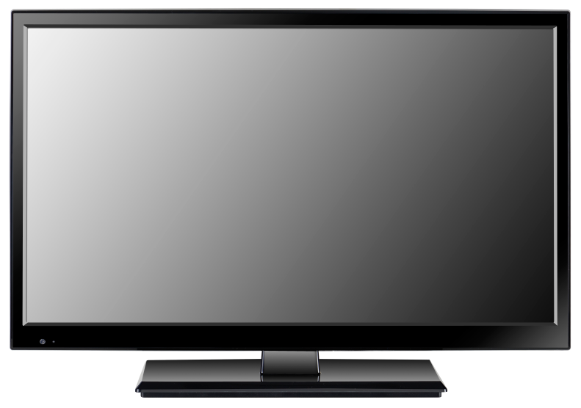
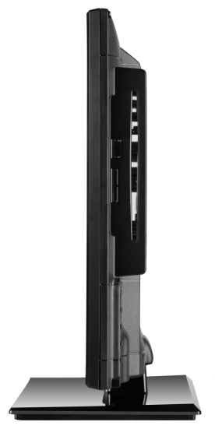
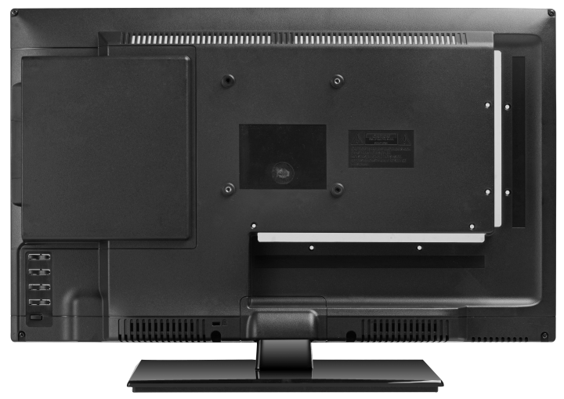
SSF Series
H12/H13
Screen size : 13.3’’/15.6”/18.5”/21.5”/23’’/23.6”/24’’
Super slim frame
DVD combo optional

Slide 10
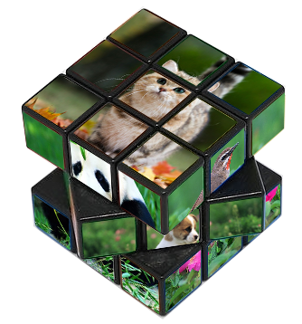

Module LED Televisions
Module LED Television
Size Variation : 15” / 35” / 45” / 52’’
Models : blah blah blah
Features : blah blah blah

Slide 11
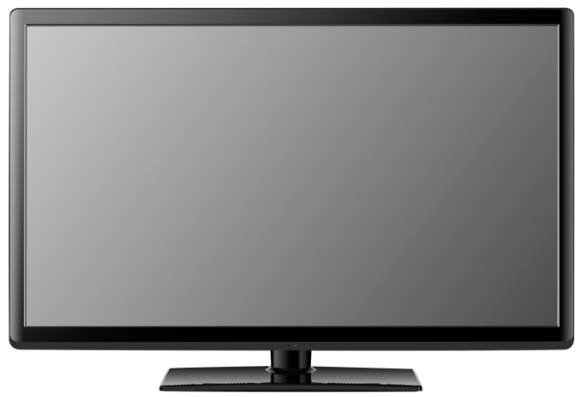
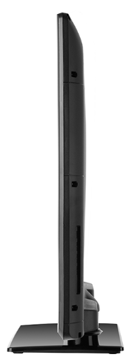
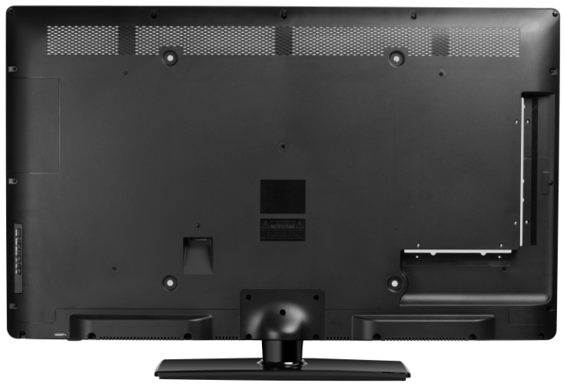
Module LED Television
32A
Screen size : 31.5’’/42’’
Super slim frame
No DVD combo

Slide 12
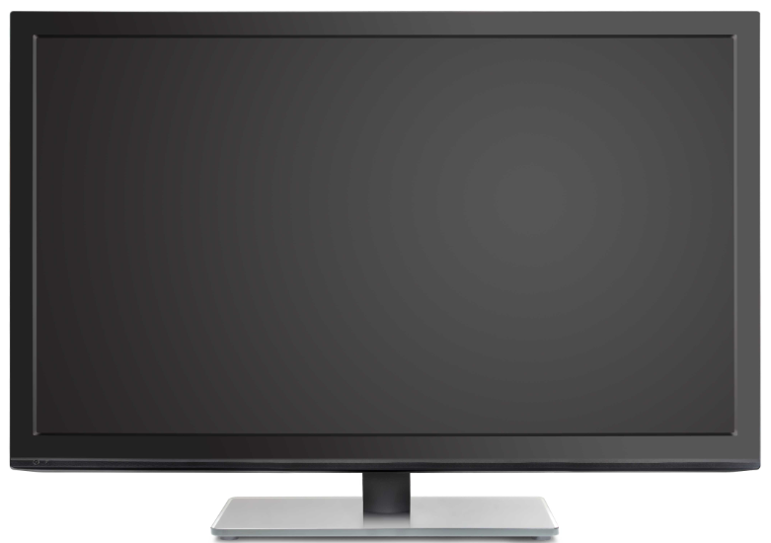
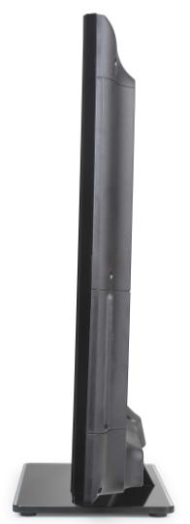
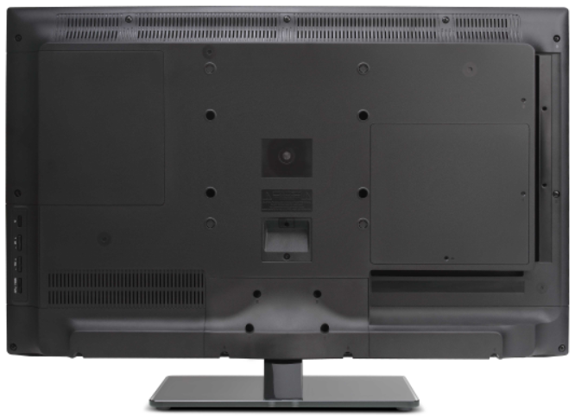
Module LED Television
BD
Screen size : 29’’/31.5’’/39’’/40’’/42’’/46’’/47’’/50’’/55’’
Super slim frame
DVD combo optional

Slide 13


Feature Televisions
Super Slim Frame LED Television
Size Variation : 15” / 35” / 45” / 52’’
Models : blah blah blah
Features : blah blah blah

Slide 14
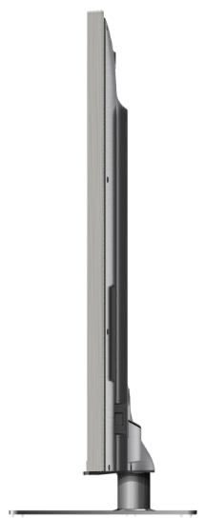
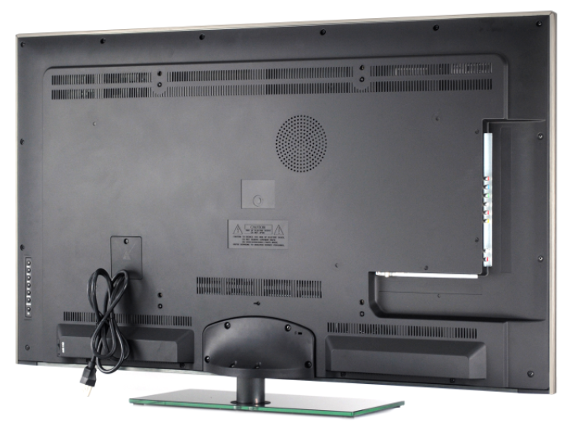
Feature Televisions
Frameless
Screen size : 42’’/47’’/55’’
Marvelous frameless design
Polarized 3D-image function available
Top quality Art-5 screen branded with Korean LG

Slide 15
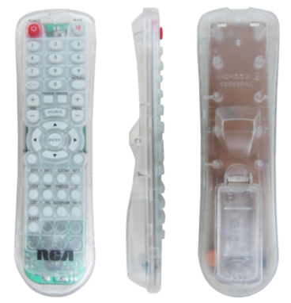
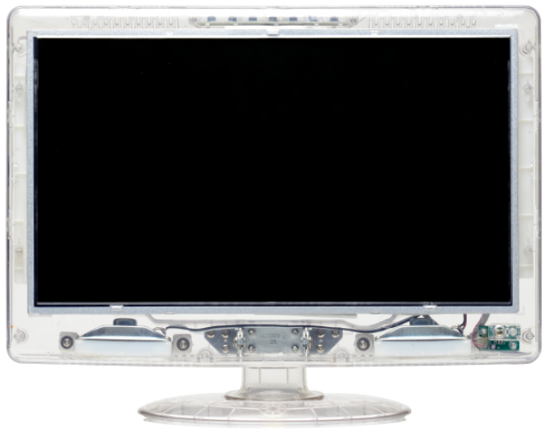
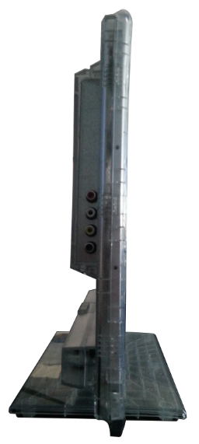
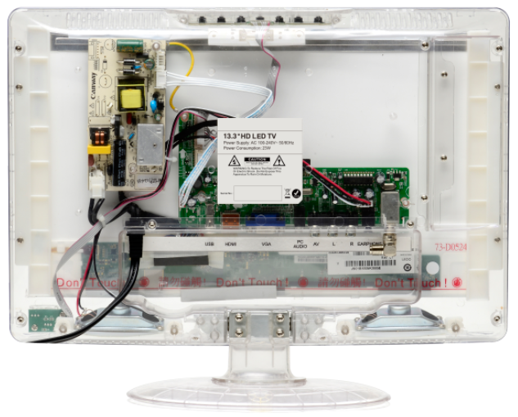
Feature Televisions
Jail TV
Screen size : 13.3’’/15.6’’/18.5’’
Transparent cabinet and remote control
Customized features and user interface

Slide 16
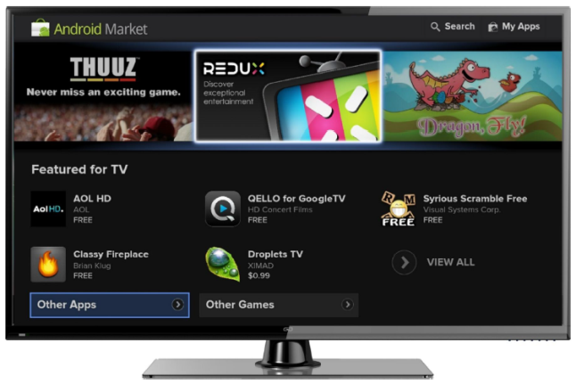
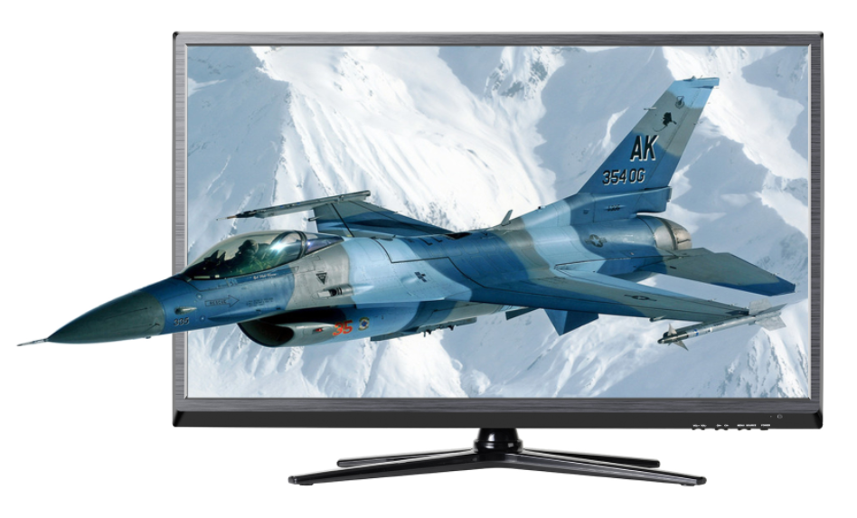
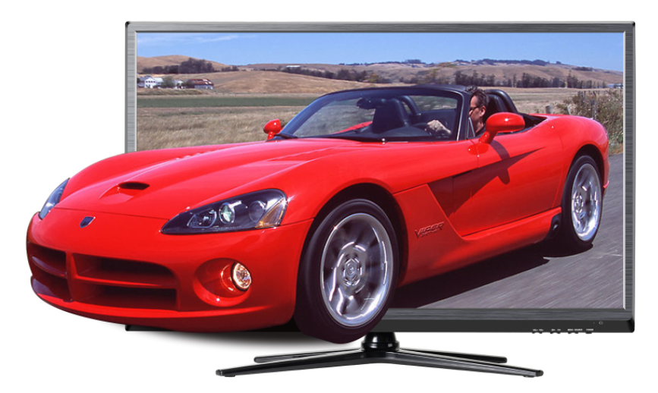
Feature Televisions
Smart/3D TV
Screen size : 42’’/47’’/55’’
Marvelous frameless design
Polarized 3D-image function available
Top quality Art-5 screen with LG brand

Slide 17
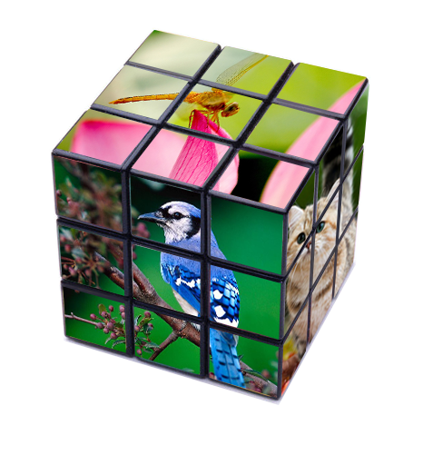

the End of the Show
the End

